Slide 1
PAYROLL MANAGEMENT SYSTEM
BY PRABIN AND SAI

Slide 2
INTRODUCTION
Payroll consists of the process by which a business pays its employees for work performed during a specific period. A payroll system allows businesses to follow a set series of processes in order to make timely, correct payments in compliance with government regulations. A payroll system may be manual or computerized and handled in-house or outsourced to another provider.

Slide 3
Objective
The payroll management system is a set of processes that helps you streamline salaries, bonuses, deductions, taxes, and other necessary aspects of the net pay of all the employees in your organization.

Slide 4
KEY FEATURES OF PAYROLL MANAGEMENT SYSTEM
Makes Payroll Systems More Organised
Ensure Data is Easy to Access
Increased Accuracy
Customisation

Slide 5
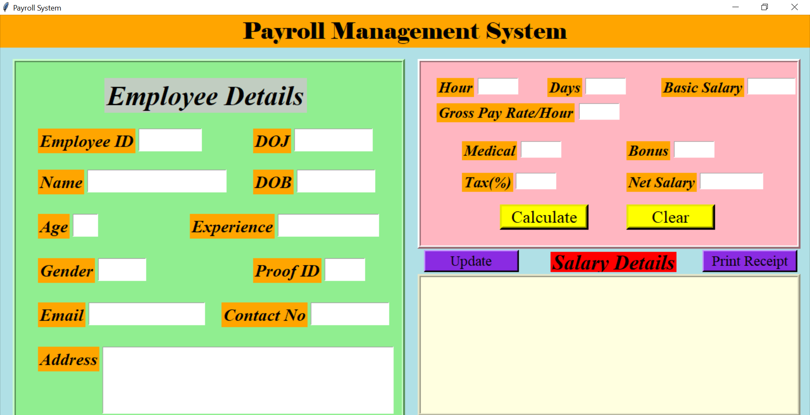
Interface of our project

Slide 6
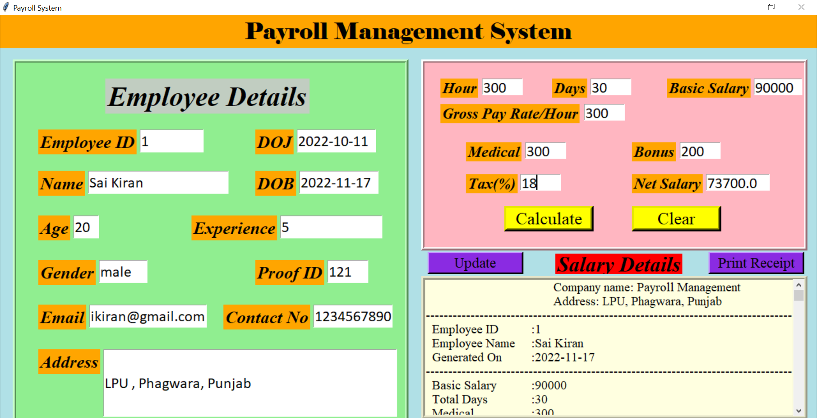
Interface of our project

Slide 7
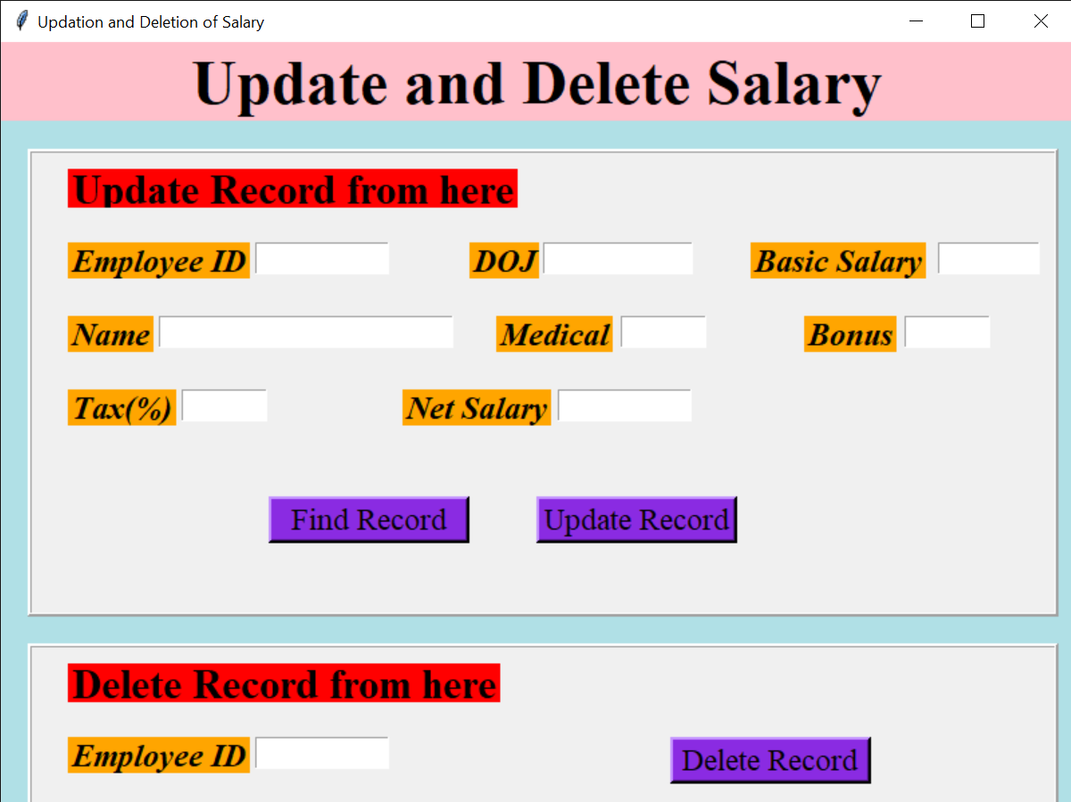
Interface of our project

Slide 8
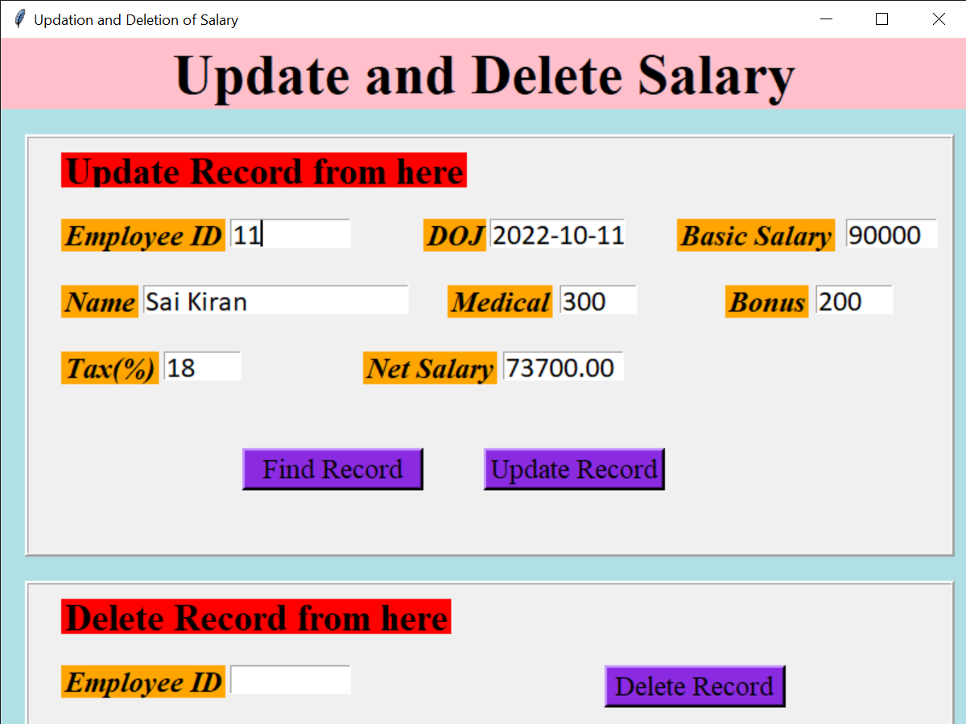
Interface of our project

Slide 9
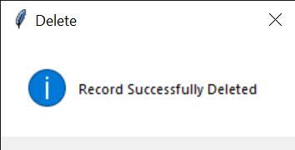
Interface of our project

Slide 10
improvements
The design could have been better.
The data is not secure.
It could have been more efficient

Slide 11
conclusion
Payroll management systems can be quite complex. However, they do make the lives of HR executives and administrators a lot easier. It is designed to replace an existing manual record system thereby reducing time taken for calculations and for storing data. The system should be strong enough to withstand regressive daily operations under conditions where the database is maintained and cleared over a certain time of span.

Slide 12
Thank you
☺

